Slide 1

State Education Funding Impact on Graduation Rates
Data Science Capstone Project
ChristaCarol Jones
June 2024

Slide 2

INTRODUCTION
This project investigates the impact of state education funding on graduation rates across the United States. By analyzing various factors such as total budget, teacher salaries, and spending per pupil, we aim to provide actionable insights for policymakers to improve educational outcomes.

Slide 3
PROBLEM STATEMENT
Graduation rates vary significantly across states, influenced by several factors, including funding. Understanding these factors can help in making informed decisions to enhance educational outcomes.

Slide 4
OBJECTIVES
Analyze the relationship between state funding and graduation rates.
Identify key factors influencing graduation rates.
Provide recommendations for policymakers to improve educational outcomes.

Slide 5
DATA OVERVIEW
Datasets Used:
State funding data
Graduation rates from 2016 to 2021
Preprocessing Steps:
Data cleaning
Handling missing values
Feature engineering

Slide 6
METHODOLOGY
Modeling Techniques:
Random Forest
Gradient Boosting
Hyperparameter Tuning:
GridSearchCV for optimization

Slide 7
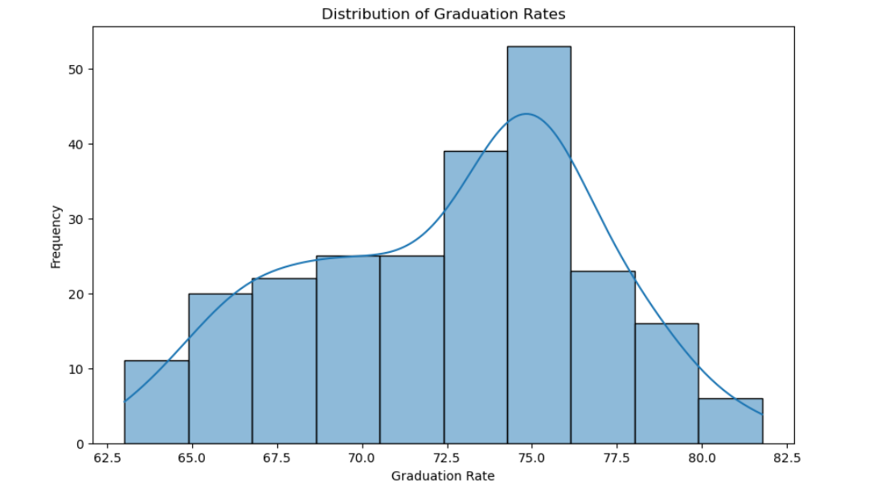
FEATURE IMPORTANCE
Random Forest: Clear feature importances, easier to interpret
Gradient Boosting: Provides feature importances, less intuitive

Slide 8
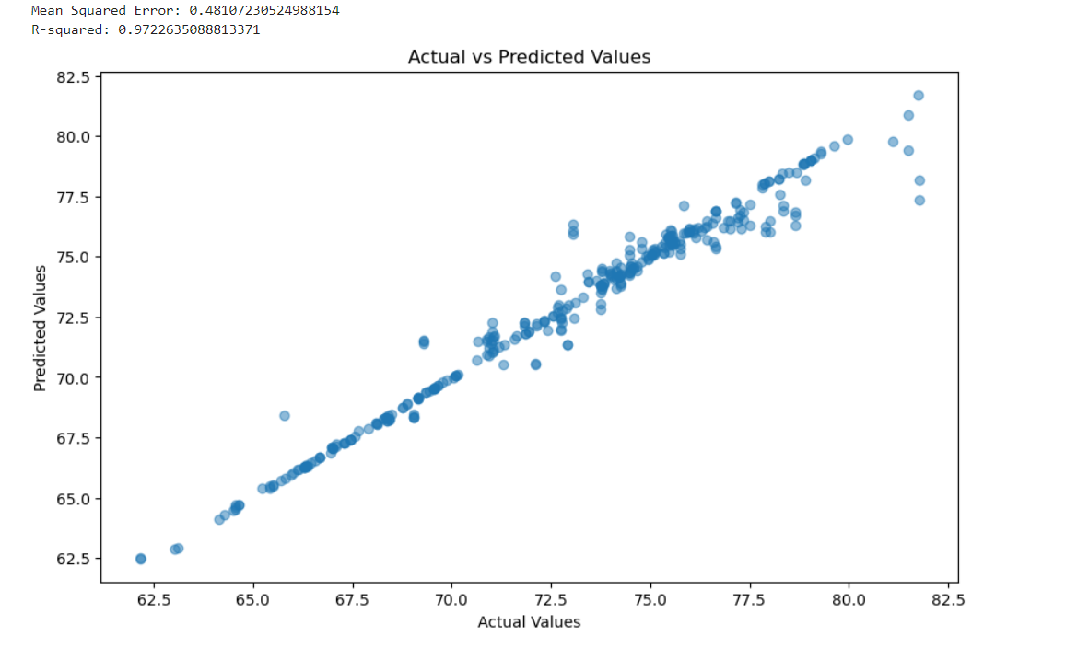
MODEL PERFORMANCE
Random Forest:
Mean Squared Error (MSE): 0.481
R-squared: 0.972
Gradient Boosting:
Mean Squared Error (MSE): 0.619
R-squared: 0.964

Slide 9
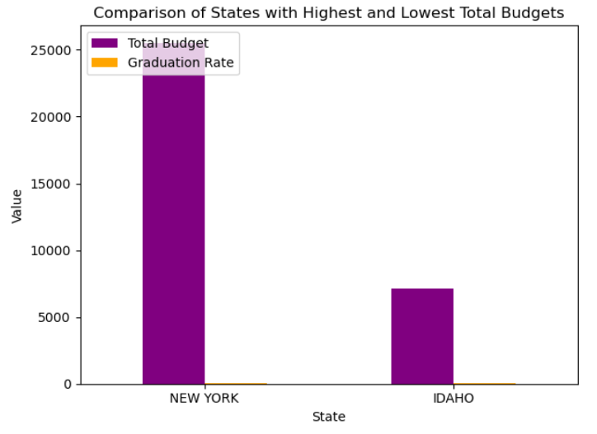
KEY FINDINGS -
BUDGET COMPARISON

Slide 10
KEY FINDINGS -
TEACHER SALARIES

Slide 11
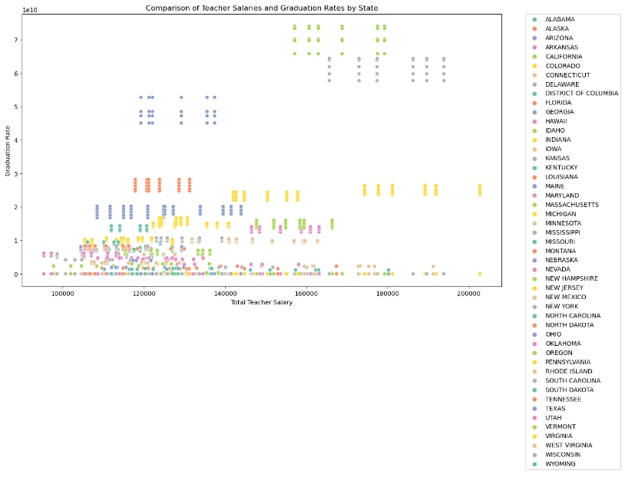

Slide 12
INSIGHTS
No clear linear correlation between total budget and graduation rates.
Variability in graduation rates within similar budget ranges suggests other factors at play.
Teacher salaries show a stronger correlation with graduation rates.

Slide 13
RECOMMENDATIONS
Increase Funding: Allocate more resources to states with lower graduation rates.
Improve Teacher Salaries: Focus on enhancing teacher compensation to improve outcomes.
Targeted Interventions: Implement specific strategies in states with lower budget efficiency.

Slide 14

CONCLUSION
The analysis provides valuable insights into the relationship between state funding and educational outcomes.
Recommendations are aimed at helping policymakers make informed decisions to improve graduation rates.

Slide 15
FURTHER RESEARCH
Explore additional factors influencing graduation rates.
Conduct longitudinal studies to assess the long-term impact of funding changes.

Slide 16
Q & A

